Slide 1

Prototype Design of User Interface
THEMIS
EE308 - Assignment 5：
Group 1: THEMIS
Speaker: Zhou Wenxuan

Slide 2
Content
Part 1: Introduction
Part 2: Designers
Part 3: Developing Tools
Part 4: Design Details

Slide 3
Introduction
Part 1

Slide 4
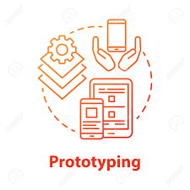
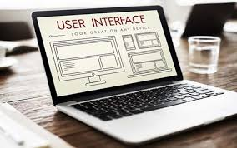
Introduction
Prototype:
A rapid software development to validate requirements. It can help to communicate, and improve the quality.
UI:
User Interface. The bridge between user and product. A good UI can improve user’s experience and product’s usability.

Slide 5
Designers
Part 2

Slide 6
Designers
 | English Name (Pinyin) | Chinese Name （中文名） | Sutdent ID
Designer 1 | Zhaoqing Lin | 林兆青 | 832101217
Designer 2 | Xinyun Li | 李欣芸 | 832101211
Designer 3 | Yuyang Hua | 华雨杨 | 832101207

Slide 7
Ratio of Workload
Name | Member Division of Labor | Proportion
Jie Huang | Participate in the interface prototype design discussion | 2.75%
Hongming Chen | Blog information collection and creation | 7.5%
Yuxiang Su | Participate in the interface prototype design discussion | 2.75%
Daming Fu | Interface prototype design specification information collection | 2.75%
Minghao Gao | Blog information collection and creation | 7.5%
Jiayi Lu | Interface prototype design specification information collection | 2.75%
Zhipeng Wang | PPT content production and page layout | 8%
Weijie Hong | Participate in the requirements document discussion | 2.75%
Yuxin Peng | Participate in the interface prototype design discussion | 2.75%
Lin Bao | Participate in the interface prototype design discussion | 2.75%
Siqi Lin | Interface prototype design specification information collection | 2.75%
Zhaoqing Lin | Interface prototype design | 15%
Xinyun Li | Interface prototype design | 15%
Yuyang Hua | Interface prototype design | 15%
Wenxuan Zhou | PPT content production and page layout + presentation | 10%

Slide 8
Developing Tools
Part 3

Slide 9

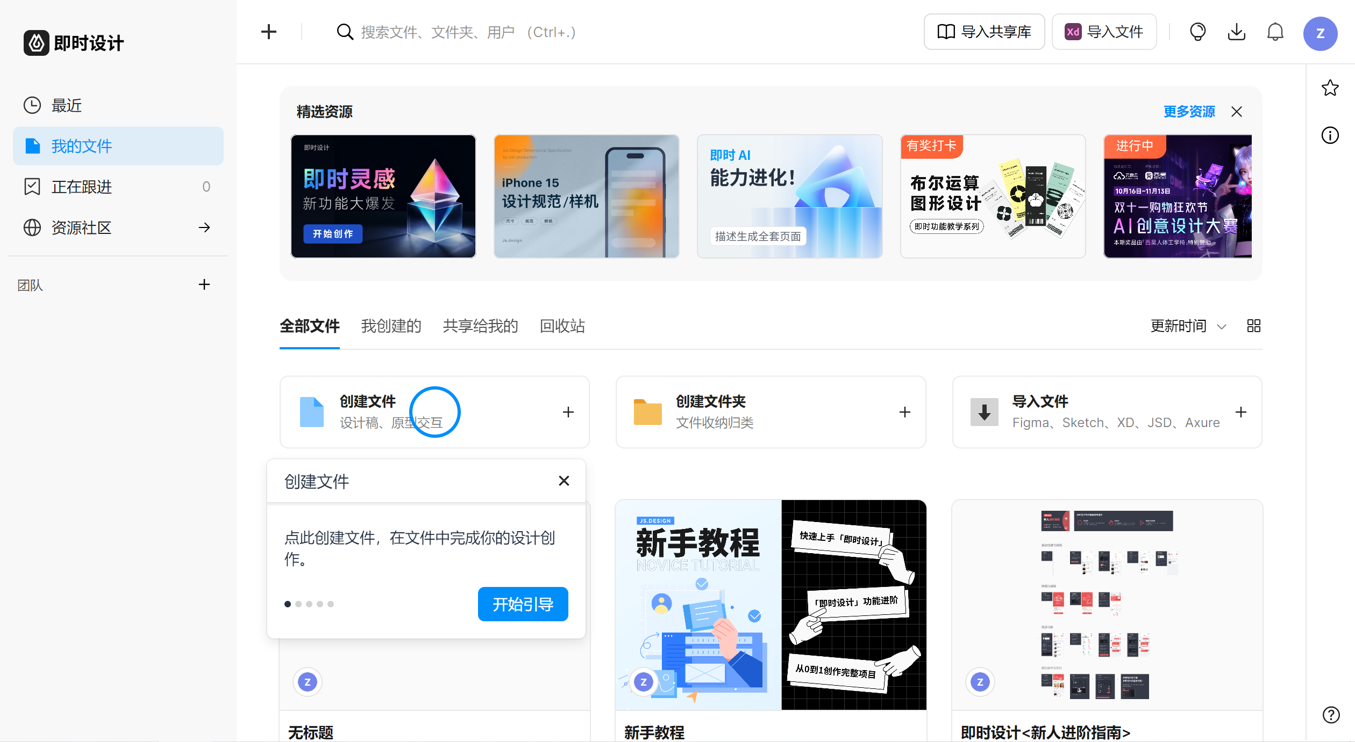
Tool: JsDesign
JsDesign is a designing platform that supports online collaboration.
Designers tried different ideas with its useful functions.

Slide 10
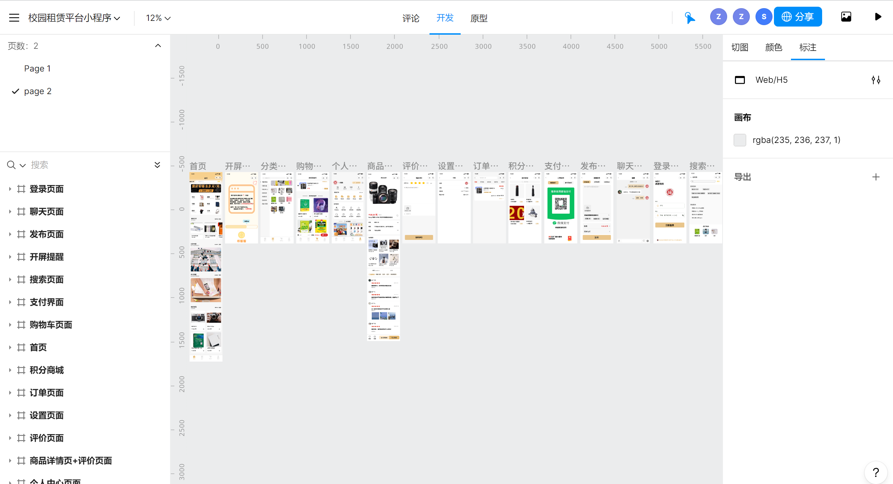
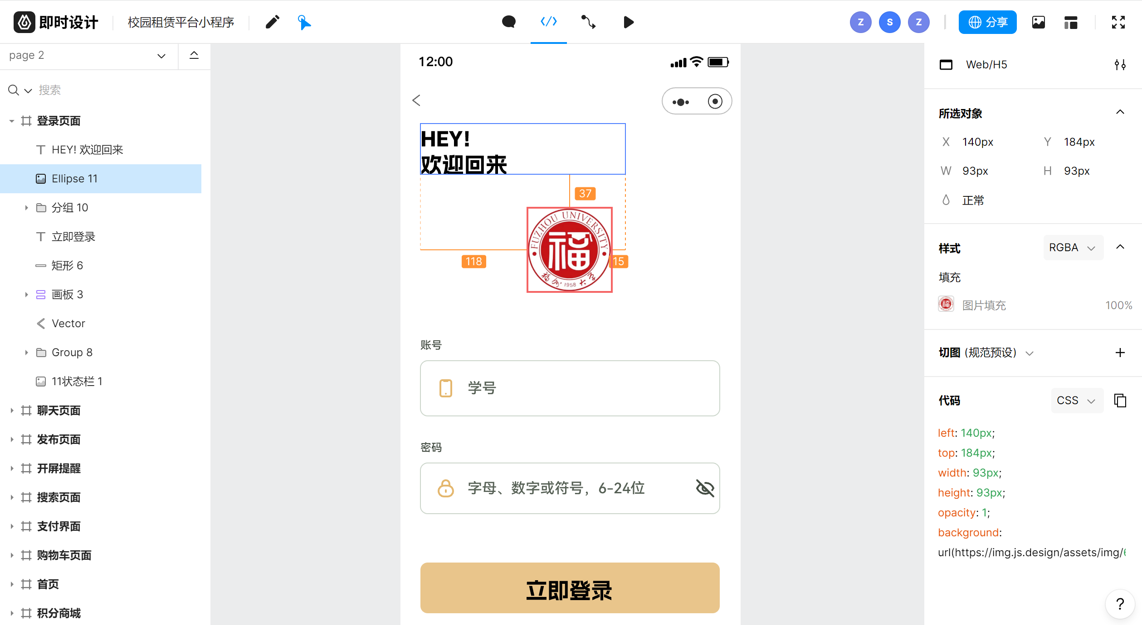
Tool: JsDesign
Developing
Prototype preview

Slide 11
Design Details
Part 4

Slide 12
Considering previous products Basing on our own requirements Making sense of user’s experience
Main ideas:

Slide 13
Key Points:
User Experience
Team concept
Functionality
Responsiveness

Slide 14
Developing Process
Discuss around the requirements, determine the division of labour.
1
Choose the tool, learn and work on designing.
3
Evaluate and improve the achievement.
4
Summarize and report.
5
Market research, analyze previous similar products.
2
*learning
*design direction
*interaction,
user experience
Designing Process

Slide 15


Main Parts
Home Page
All Items
Login
Purchasing
Personal

Slide 16
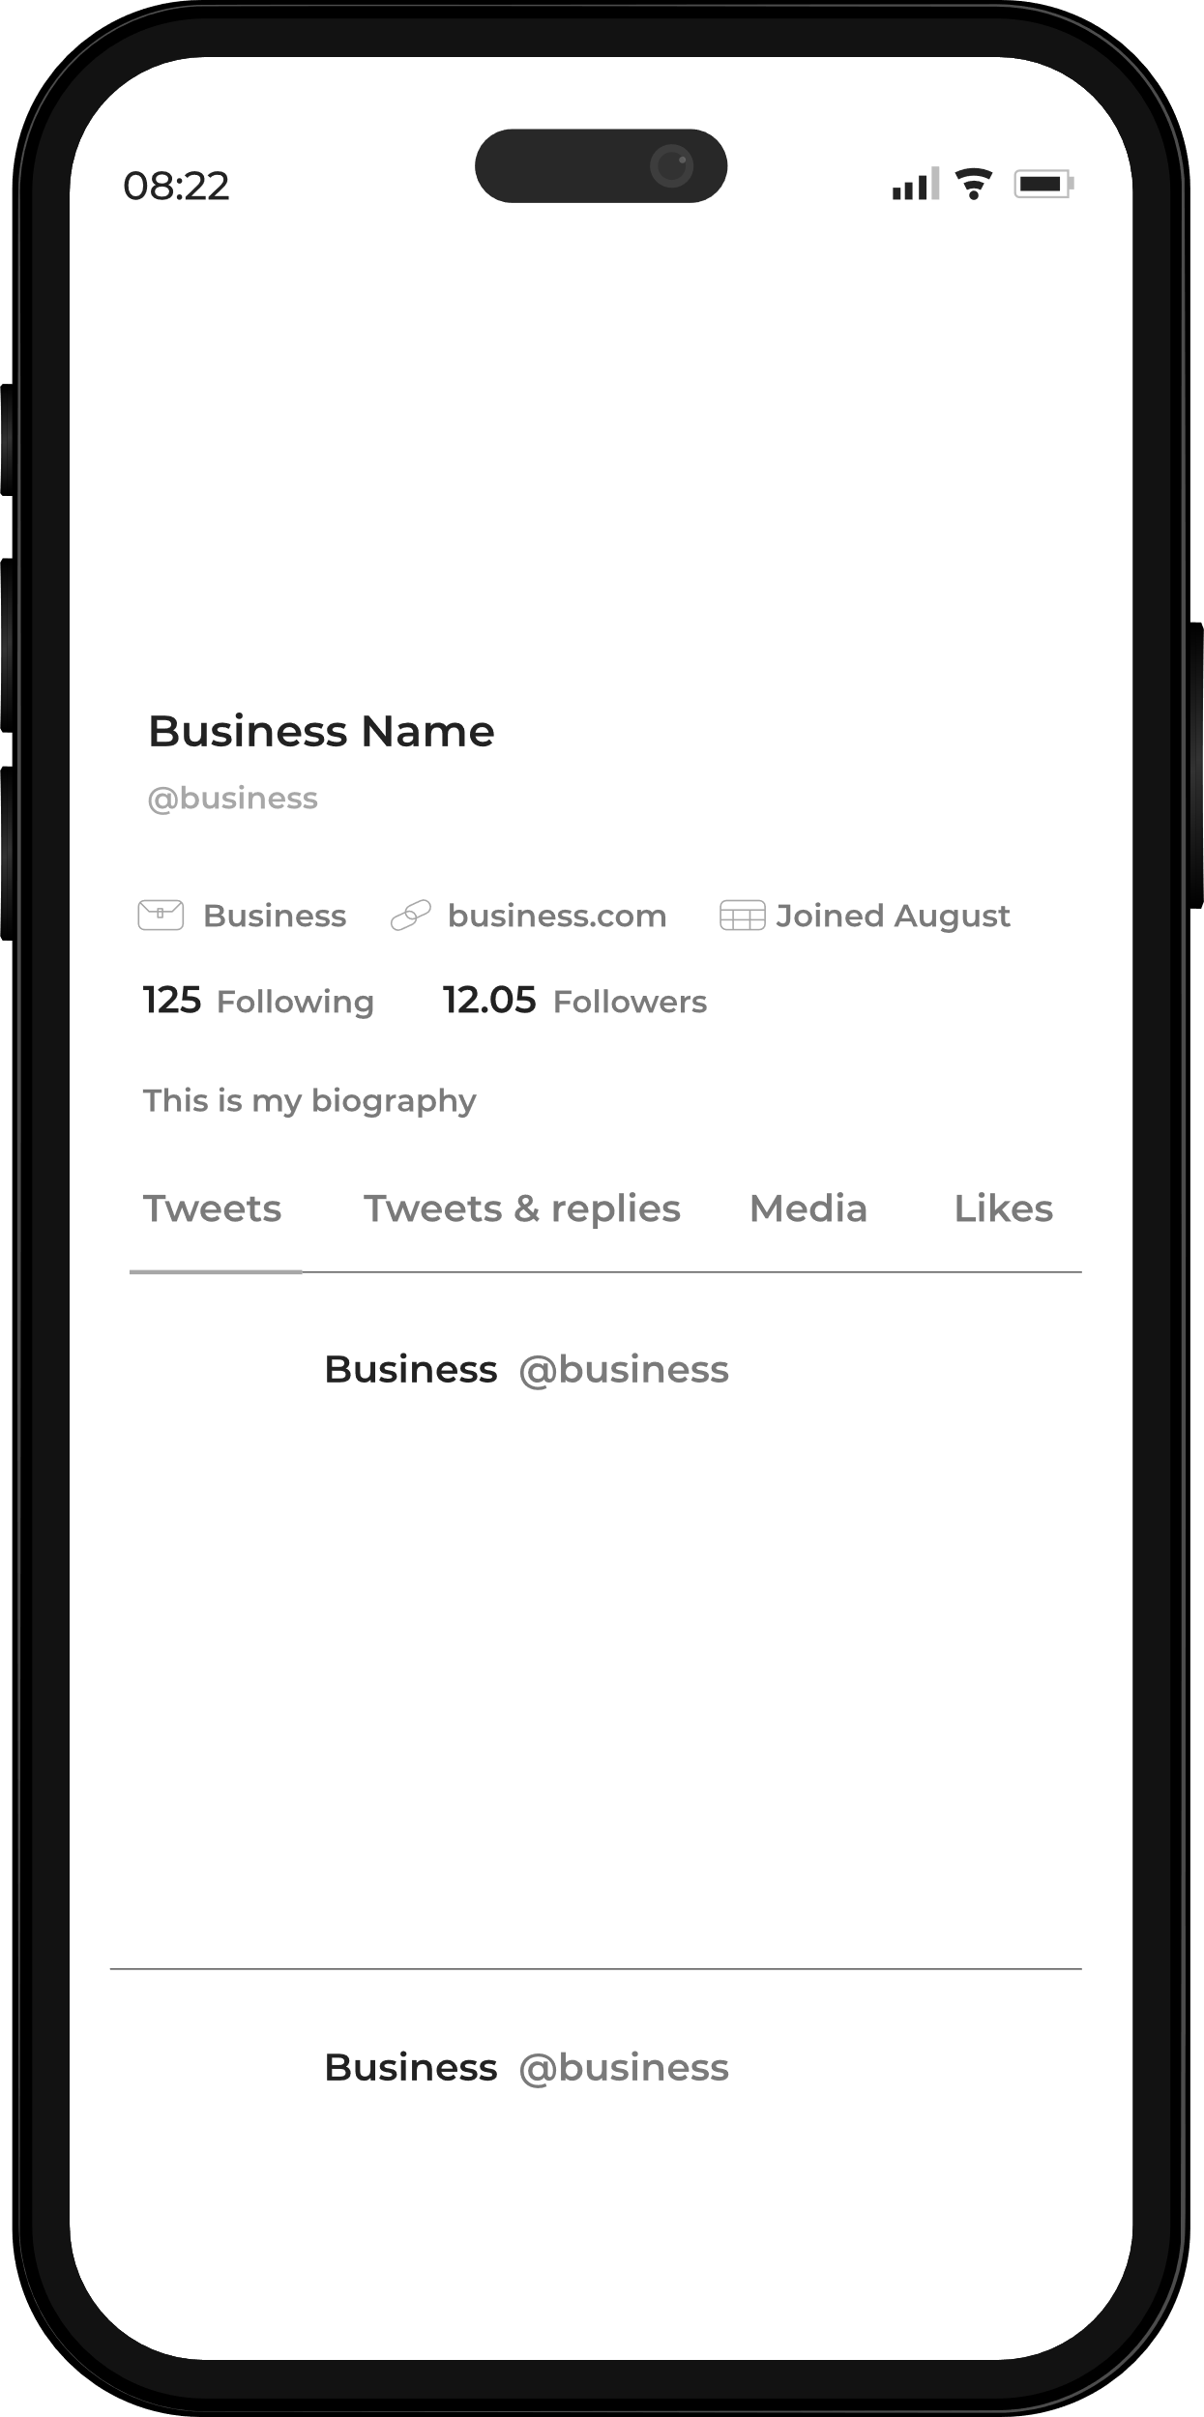
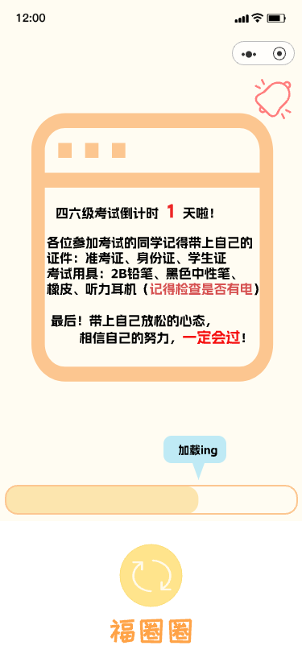
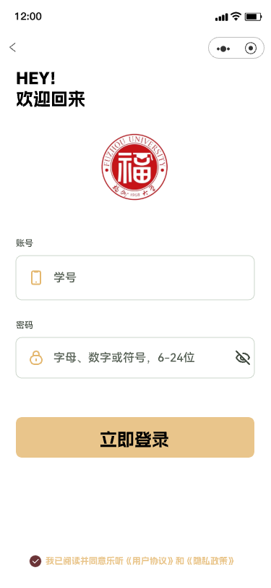
Beginning
Loading page
The loading page will display important time nodes to indicate
Login page
Login with student number and password

Slide 17
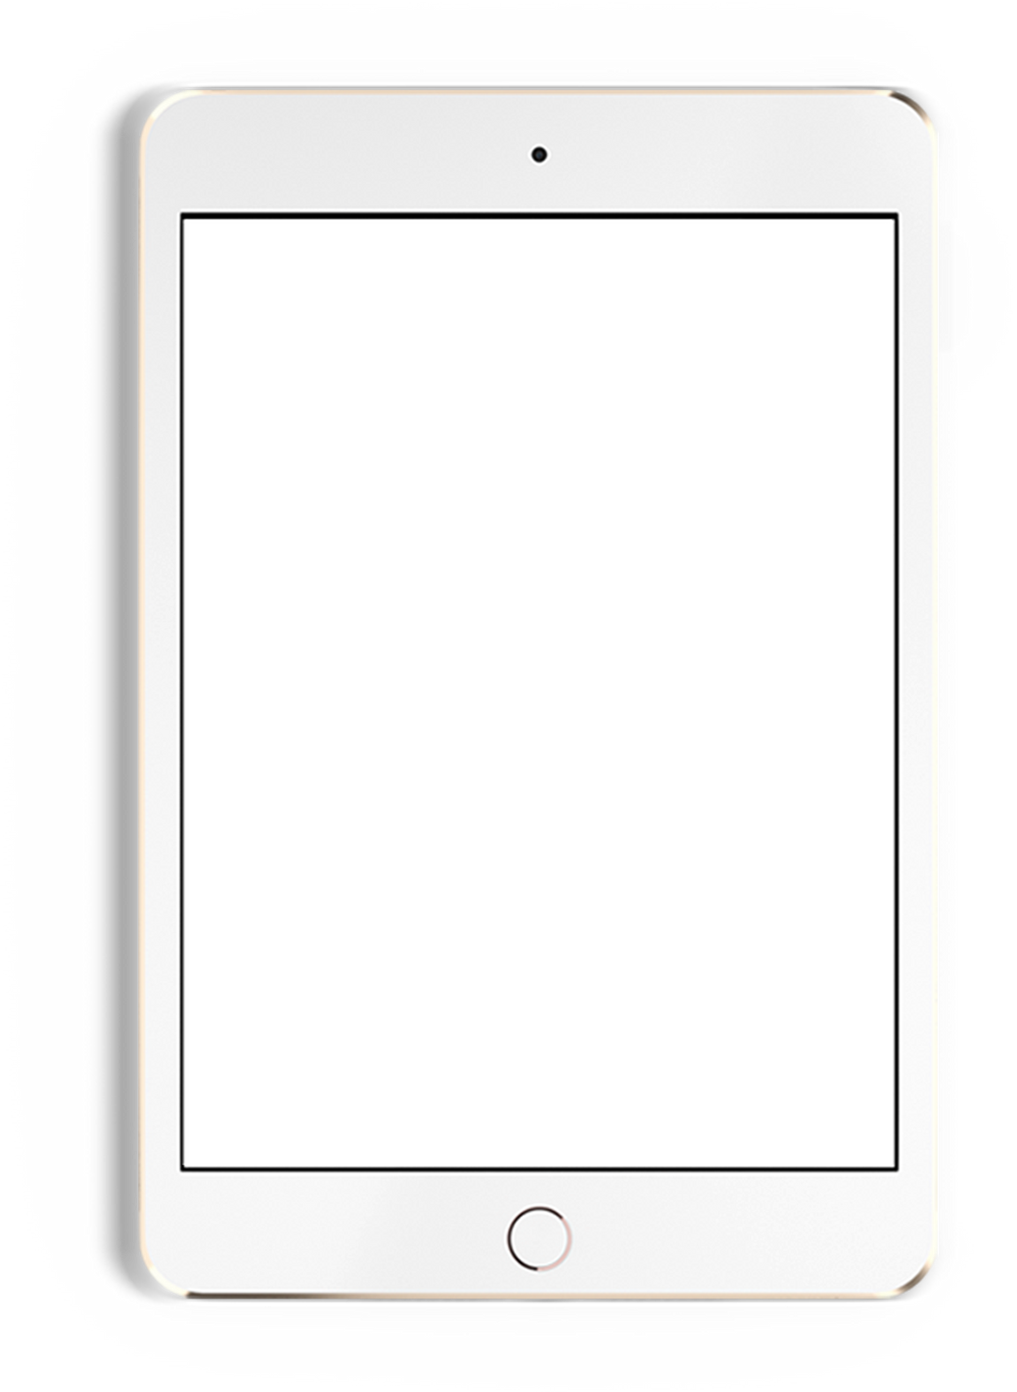
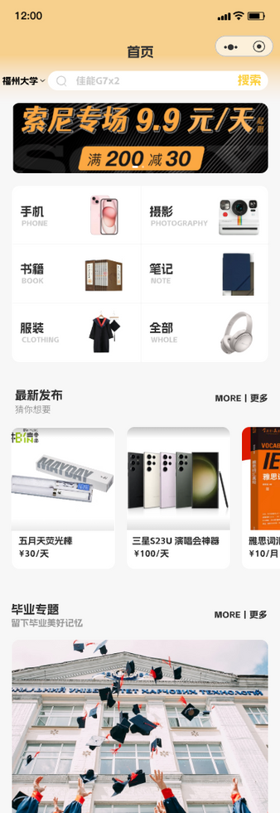
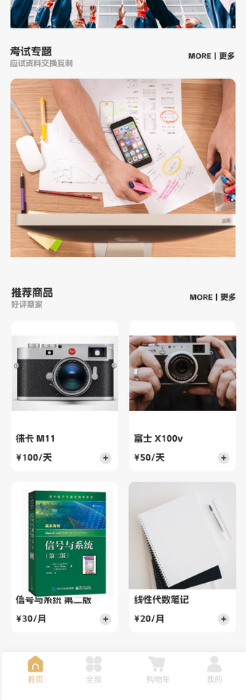
Home Page
Special topics
Search bar
Offering specialized topics (e.g. graduation topic, which includes something published by graduates)
Commodity classification
Latest release
Navigation bar

Slide 18
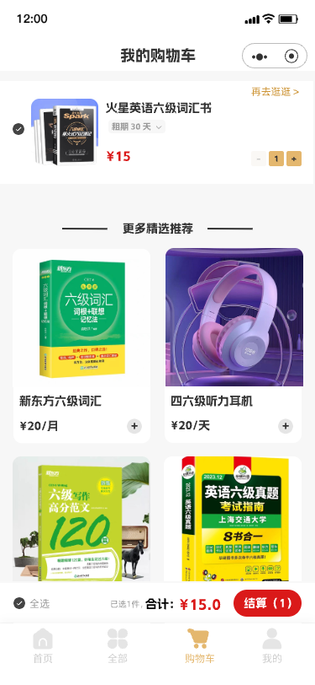
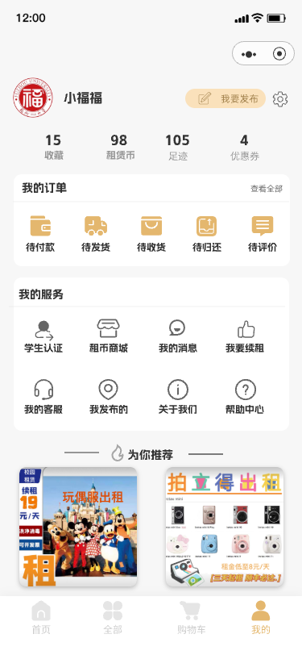
Centers
Personal center
There are more additional features in the personal center, such as student accreditation and a currency mall.
Shopping cart

Slide 19
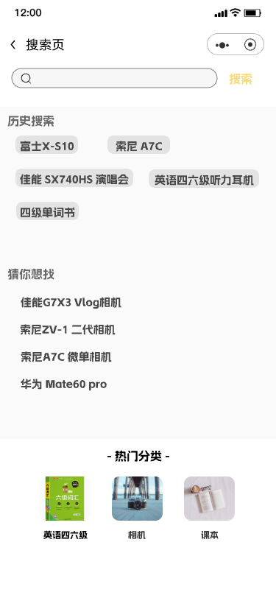
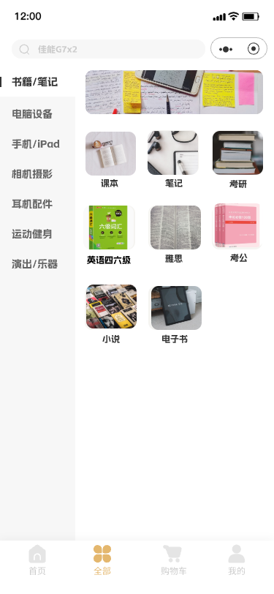
Searching
Searching bar
Popular categories

Slide 20
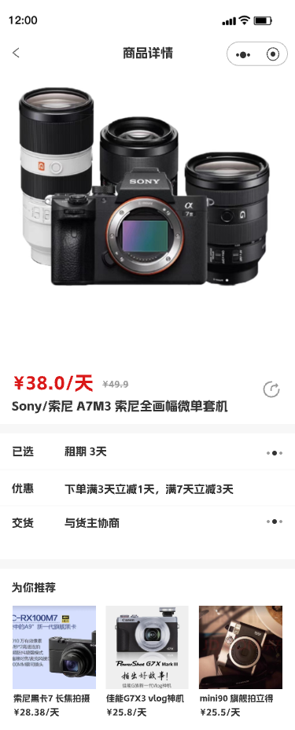
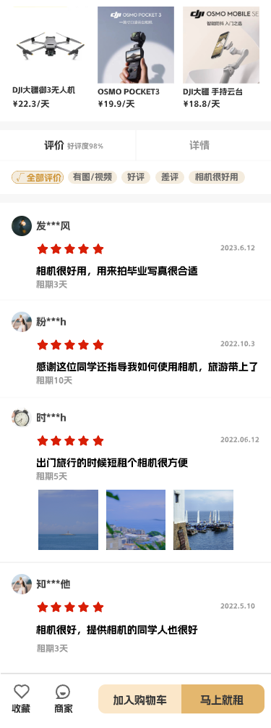

Commodity
In this interface, you can see the details of the commodity and other users’ feedback.
Commodity details
Comments reviewing

Slide 21
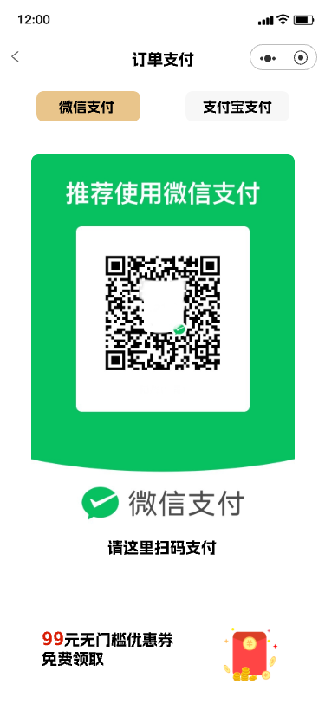
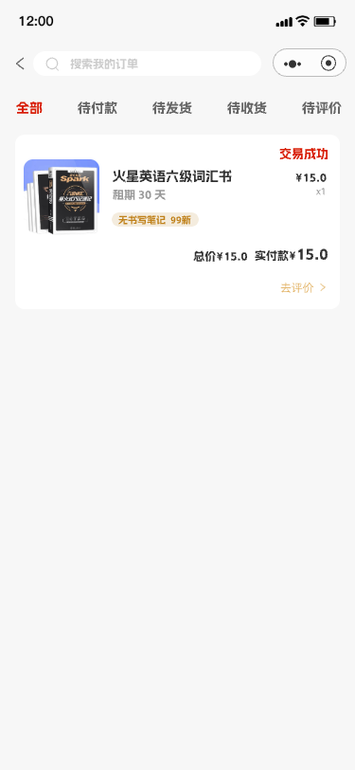
Purchasing
Payment page
Supporting various payment methods, Wechat and Alipay are available
Order page
Here is the list and the state information of different orders.

Slide 22
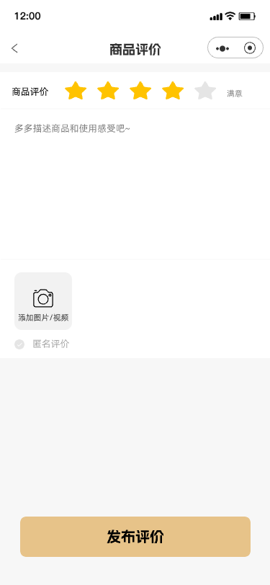
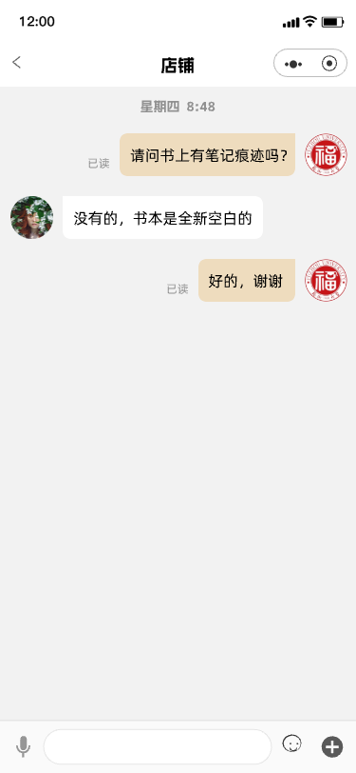
Chatting
After-sales evaluation page
After the purchase, the item can be evaluated, as other users’ reference.
Pre-sales communication page
Communication before purchase to have a better experience

Slide 23
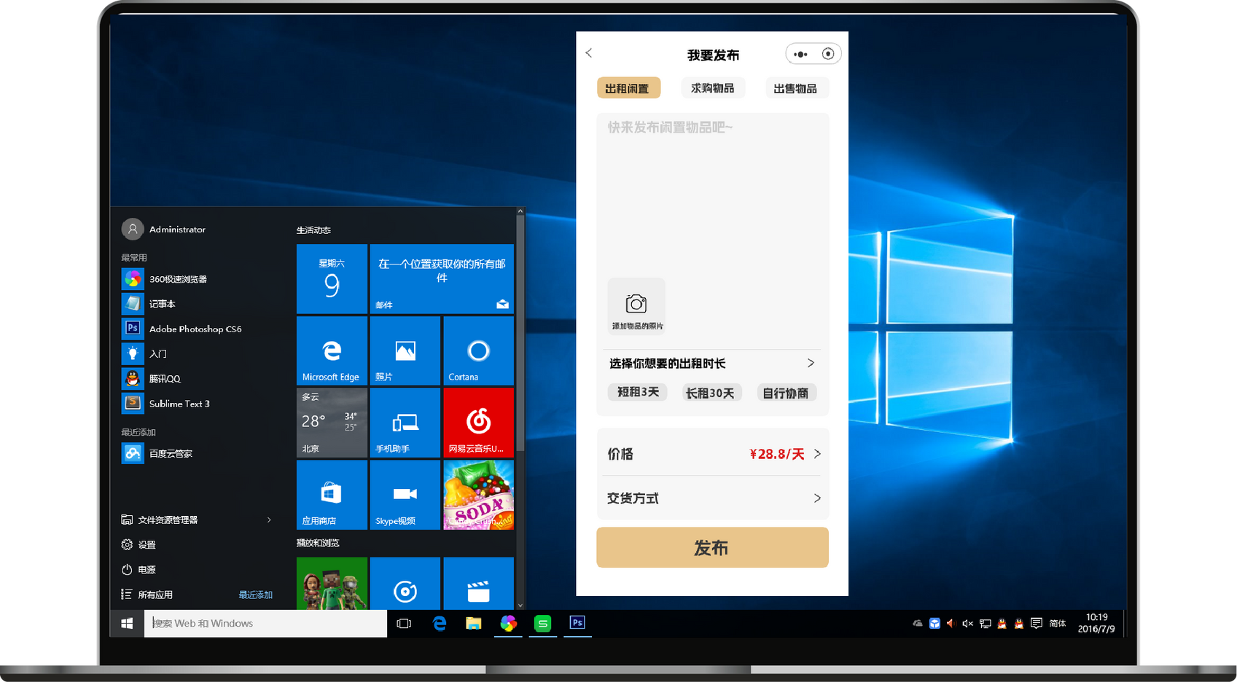
Publishing
Rental term and price setting
Type Selection
Description

Slide 24
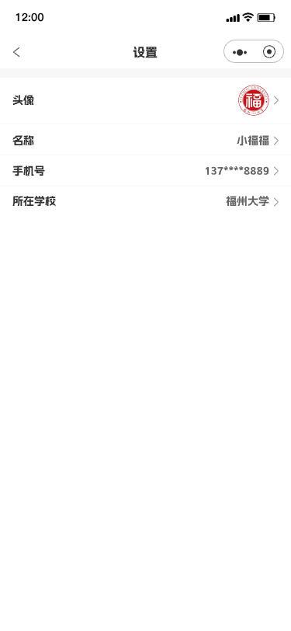
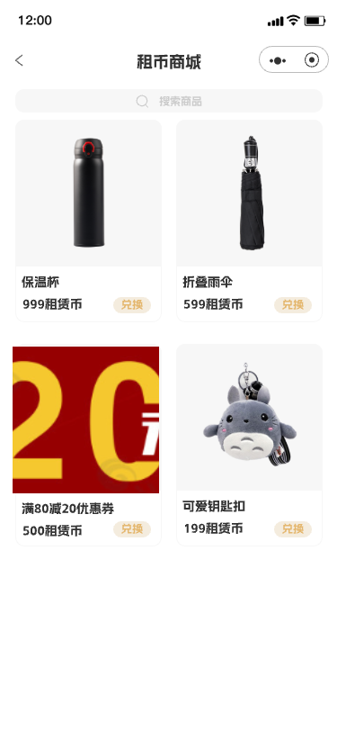
Personal Page
Personal information modification
Leasehold exchange
After each lease, you can get lease coins, which can be exchanged at the lease mall

Slide 25
Difficulties
Problems
Solutions
Screen size limitations
Complexity of interaction design
Data display and processing
Integration with back-end interfaces
Mini-program specifications and limitations
Collaboration between design and development
Using responsive design principles, testing
Breaking them down into smaller, adding cues
Using visualization, optimizing loading processes
Explaining demands clearly, more communication
Concerning them all the time, update
Regular meetings, designing handoffs, feedback

Slide 26
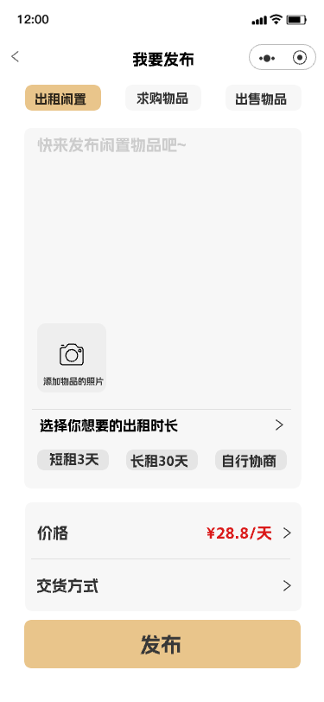
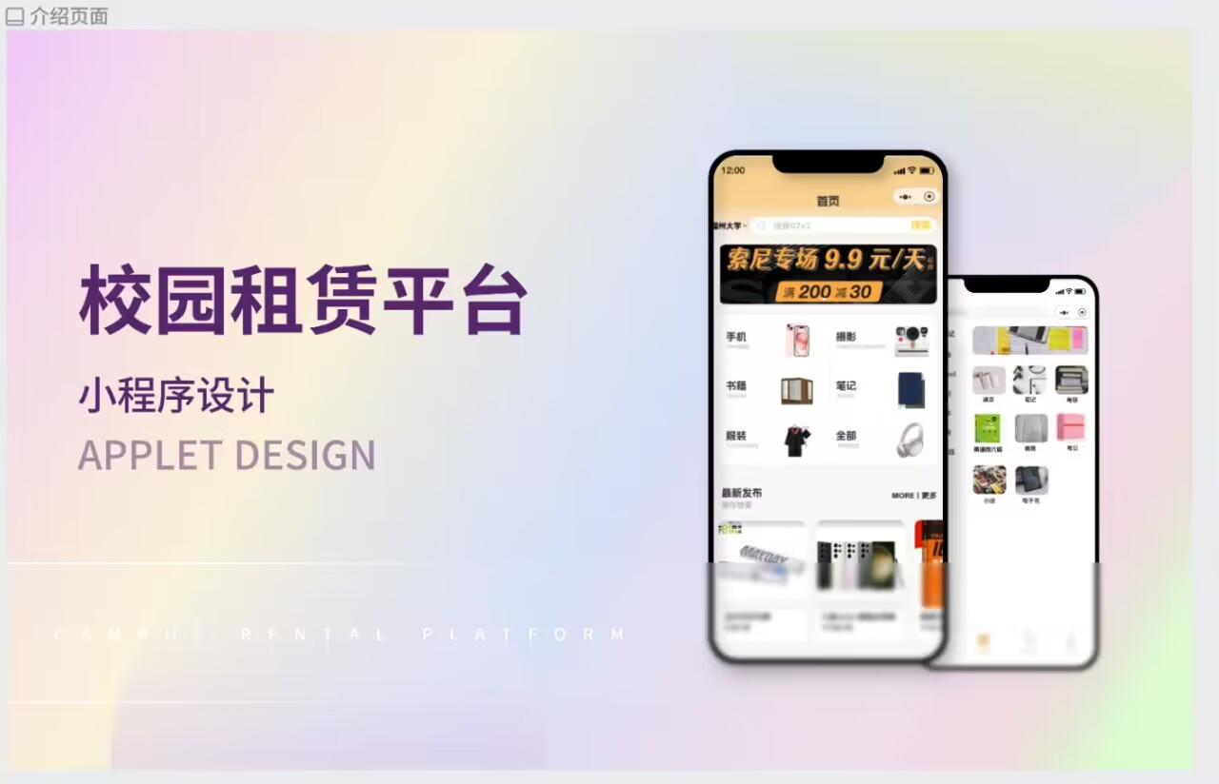
Summary
After days of hard work, we successfully created a user-friendly prototype. We learnt more about what users really need, and know more about how to design, and how to cooperate well. Besides, our achievement is very useful for next steps.

Slide 27


Thanks!
Group: THEMIS
EE308FZ, MIEC
THEMIS

